Slide 1
C47- EDA Lending Club Case Study
Done By
Manickkam S
Sachin Maruti Munde

Slide 2
Agenda:
UniVartiate analysis
Bivariate analysis
Conclusion
Acknowlegment

Slide 3
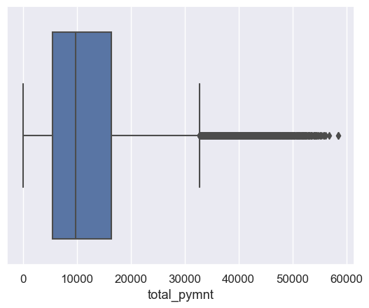
UniVariate Analysis – The average taken loan amount is Rs.10,000.

Slide 4
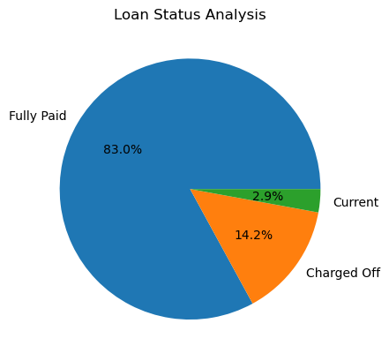
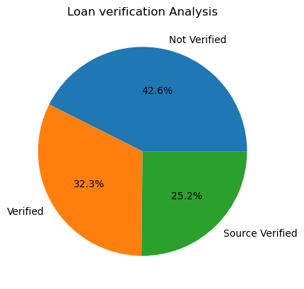
32.3% Loan are verified
25.2 % Loans are source verified
42.6% Loans are Not verified
83approach % Paid in full, and we can
for a new loan.
14.2% are charged off
2.9% are in Current, so we can request for top-up.

Slide 5
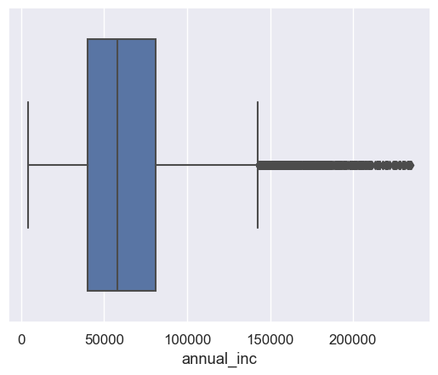
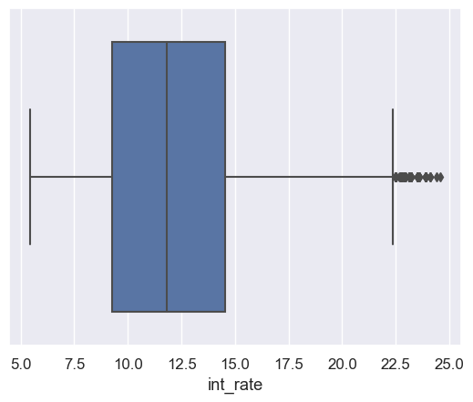
Observation On annual Income vs interest rate Average annual Income Of the Loan taker is 60,000 Average interest rate is 12 %

Slide 6
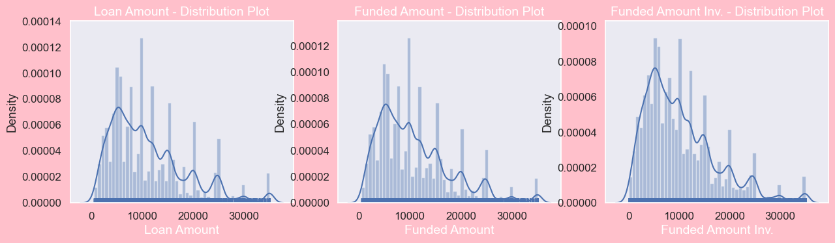
Observation on funded/Loan amount graph :

Slide 7
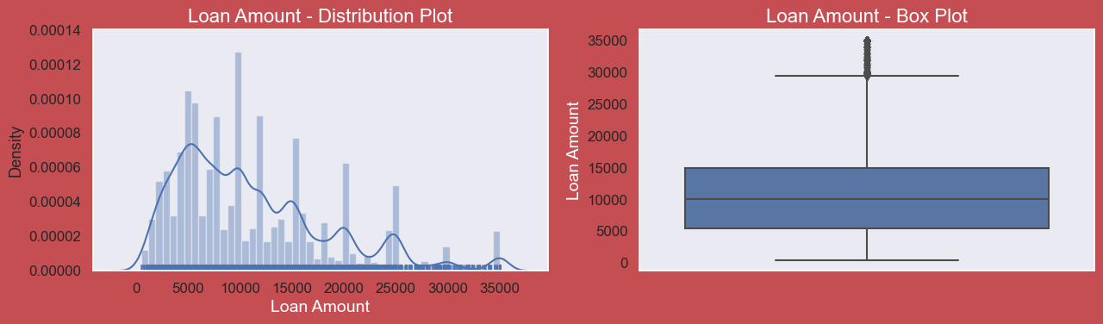
Loan Amount analysis : 1) Observation is that Loan amount, investor amount, funding amount are strongly correlated. 2) Annual income with DTI(Debt-to-income ratio) is negatively correlated. 3) Debt income ratio is the percentage of a consumer's monthly gross income that goes toward paying debts. 4) That means when annual income is low DTI is high & vice versa. 5) Positive correlation between annual income and employment years.That means income increases with work experience

Slide 8
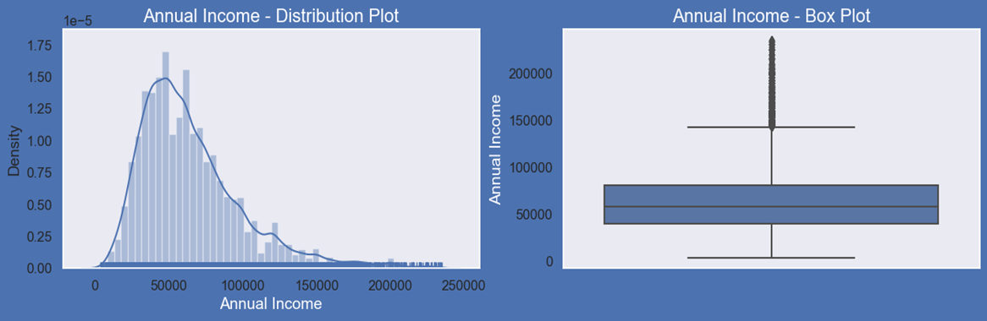
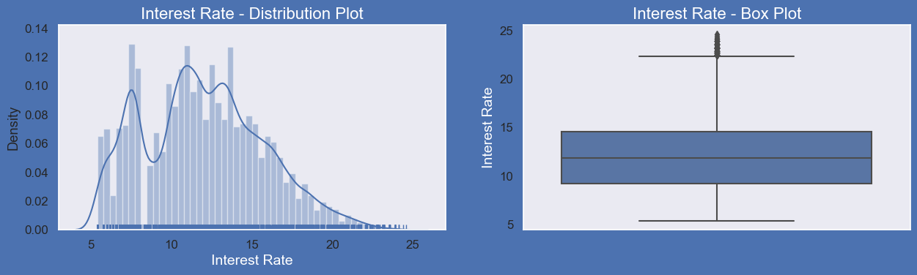
Annual Income – Distribution Plot

Slide 9
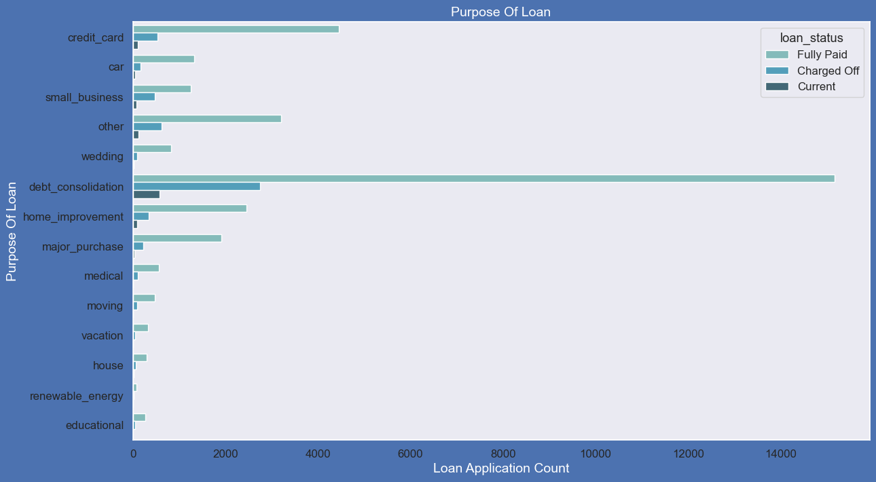
Debt consolidation plays a major role in the purpose of loan requirement

Slide 10
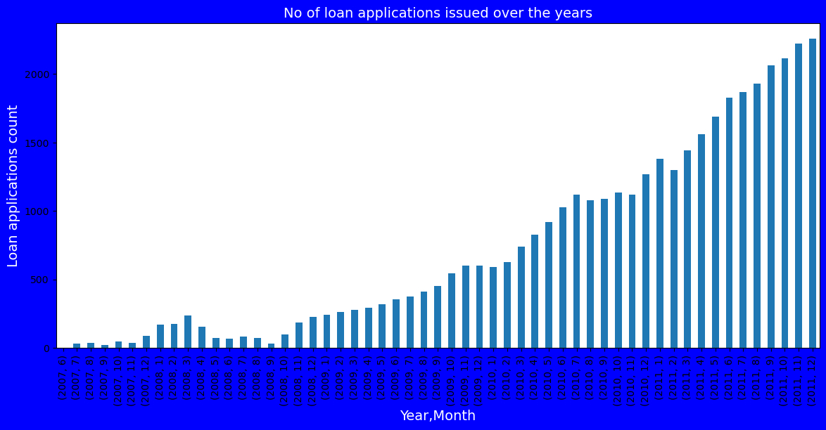
Loan applications has been gradually increased over the year with minor fluctuation

Slide 11
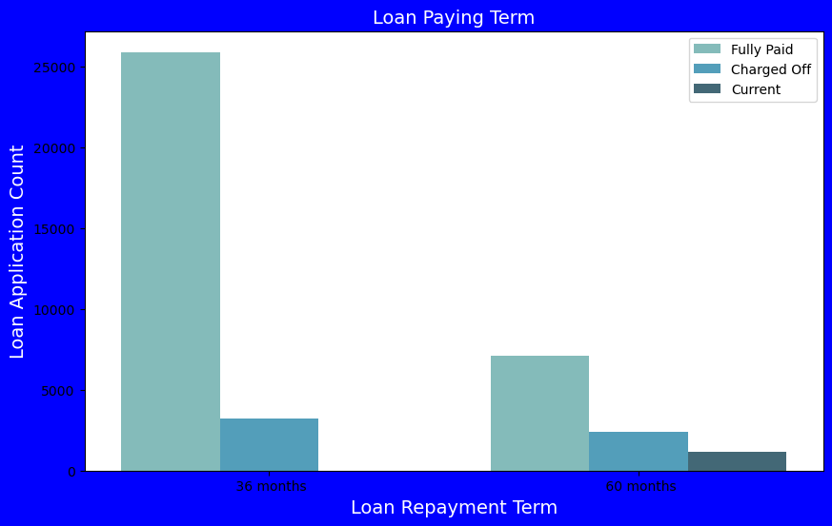
Loan Repayment Graph

Slide 12
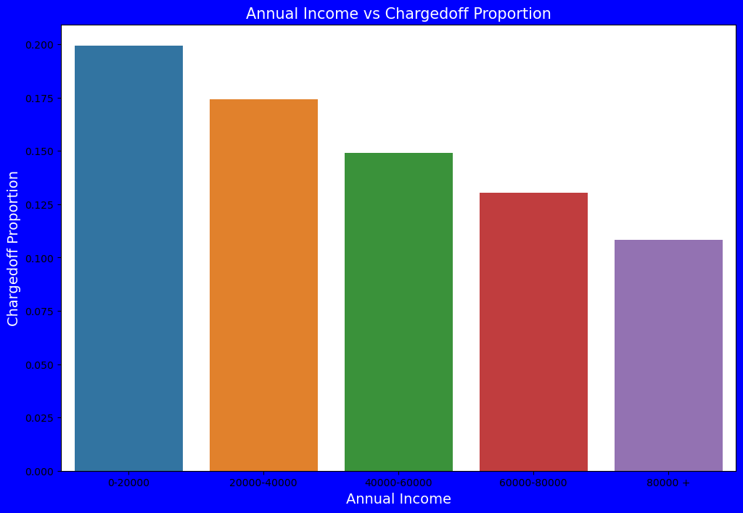
Bivariate Analysis on annual income against Chargedoff_Proportion

Slide 13
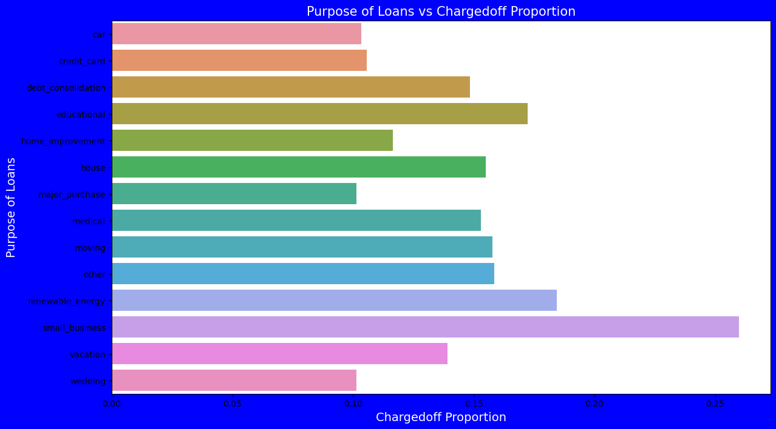
Observation on Loan vs charged off : Small business loan may lead to high % charge off

Slide 14
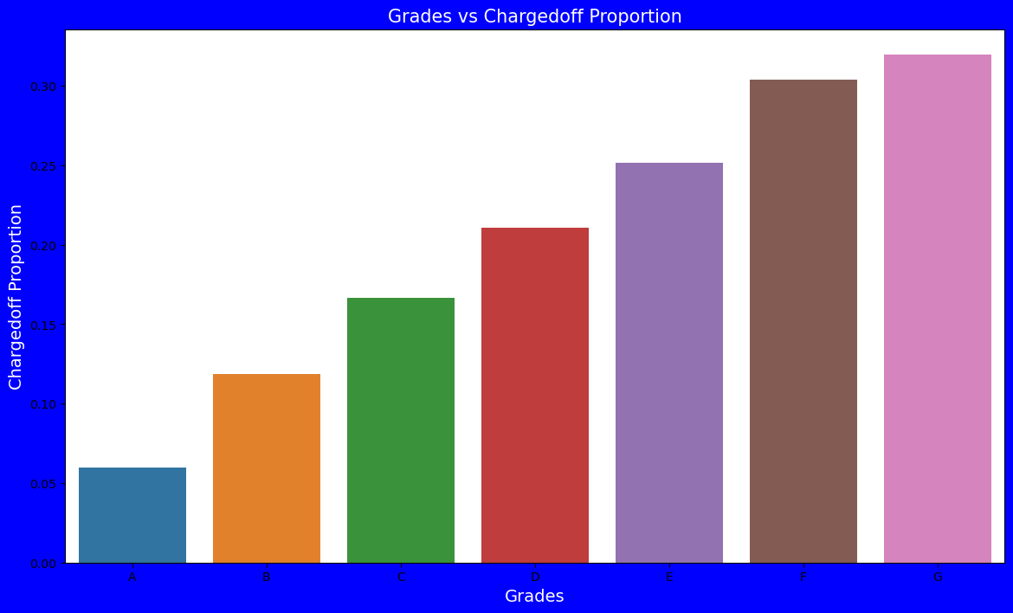
Observations on Chargedoff_Proportion: 1) Grade "A" has very less chances of charged off. 2) Grade "F" and "G" have very high chances of charged off. 3) Chances of charged off is increasing with grade moving from "A" towards "G"

Slide 15
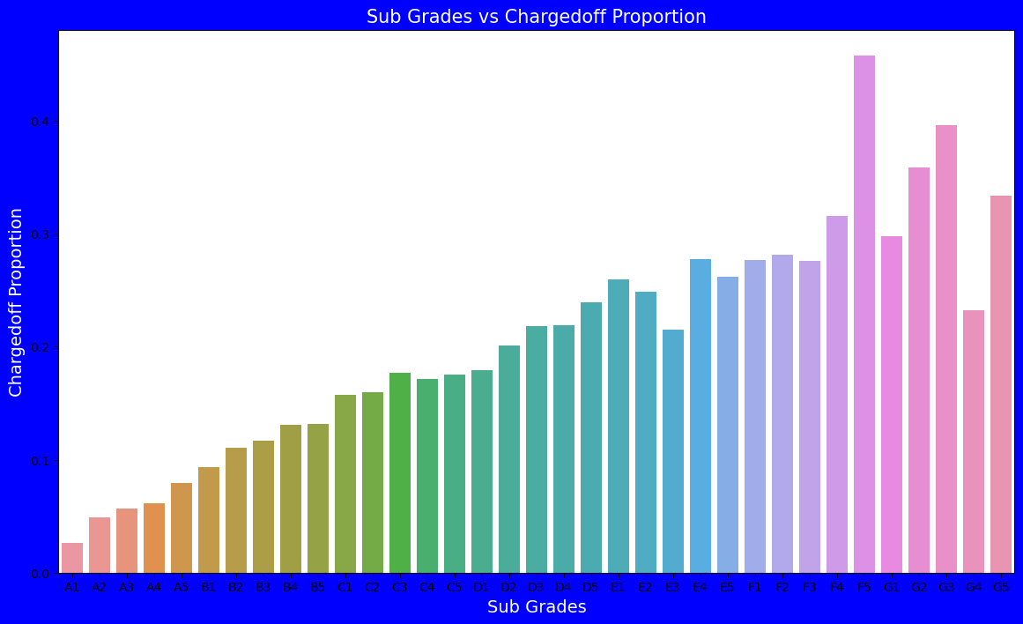
Observations: 1) Sub Grades of "A" has very less chances of charged off. 2) Sub Grades of "F" and "G" have very high chances of charged off. 3) Proportion of charged off is increasing with sub grades moving from sub grades of "A" towards sub grades of "G"

Slide 16
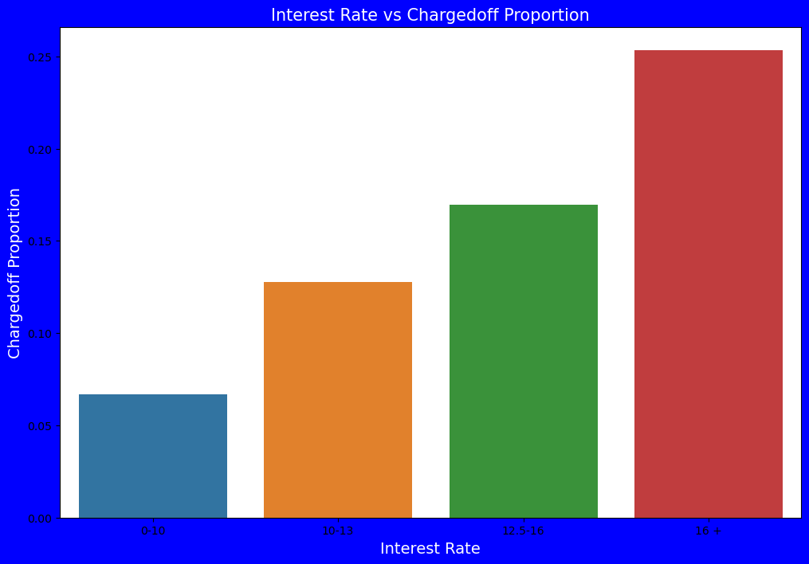
Observations on Interest rate vs charged off: 1) interest rate less than 10% has very less chances of charged off. Interest rates are starting from minimum 5 %. 2) interest rate more than 16% has good chances of charged off as compared to other category interest rates. 3) Charged off proportion is increasing with higher interest rates.

Slide 17
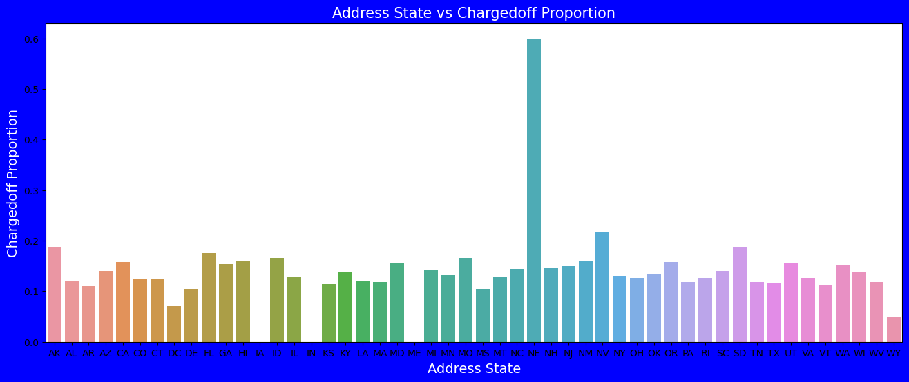
Observations On Address vs charged off propostion : 1) states NE has very high chances of charged off but number of applications are too low to make any decisions. 2) NV,CA and FL states shows good number of charged offs in good number of applications.

Slide 18
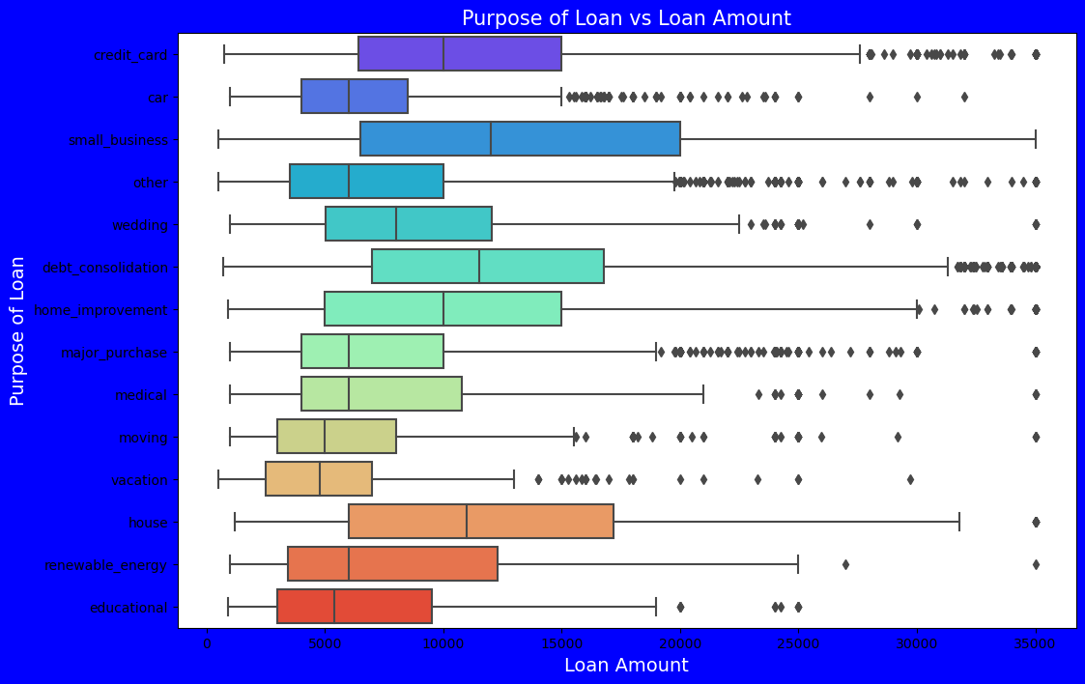
Observation on purpose Of loan vs Loan amount: 1) Median,95th percentile,75th percentile of loan amount is highest for loan taken for small business purpose among all purposes. 2) Debt consolidation is second and Credit card comes 3rd.

Slide 19
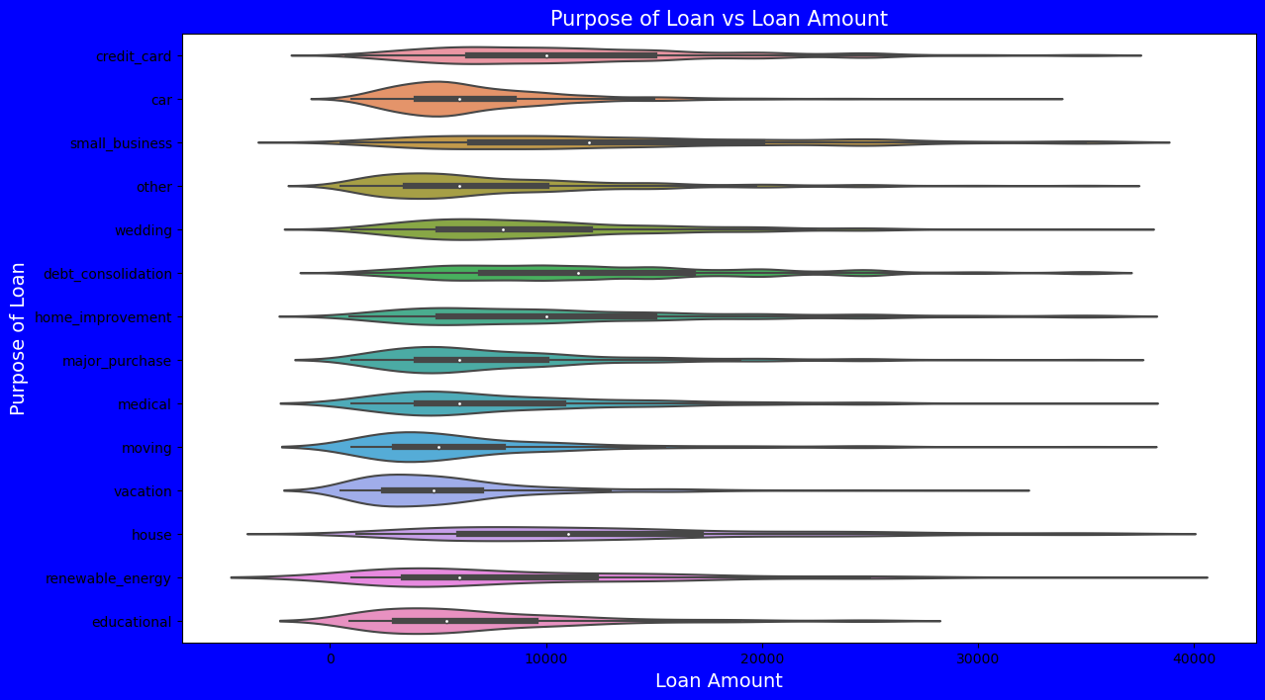
Observation on purpose Of loan vs Loan amount: 1) Loan taken for small business purpose, Debt consolidation and Credit card are somewhat evenly distributed 2) as compare to loan taken for other purposes.

Slide 20
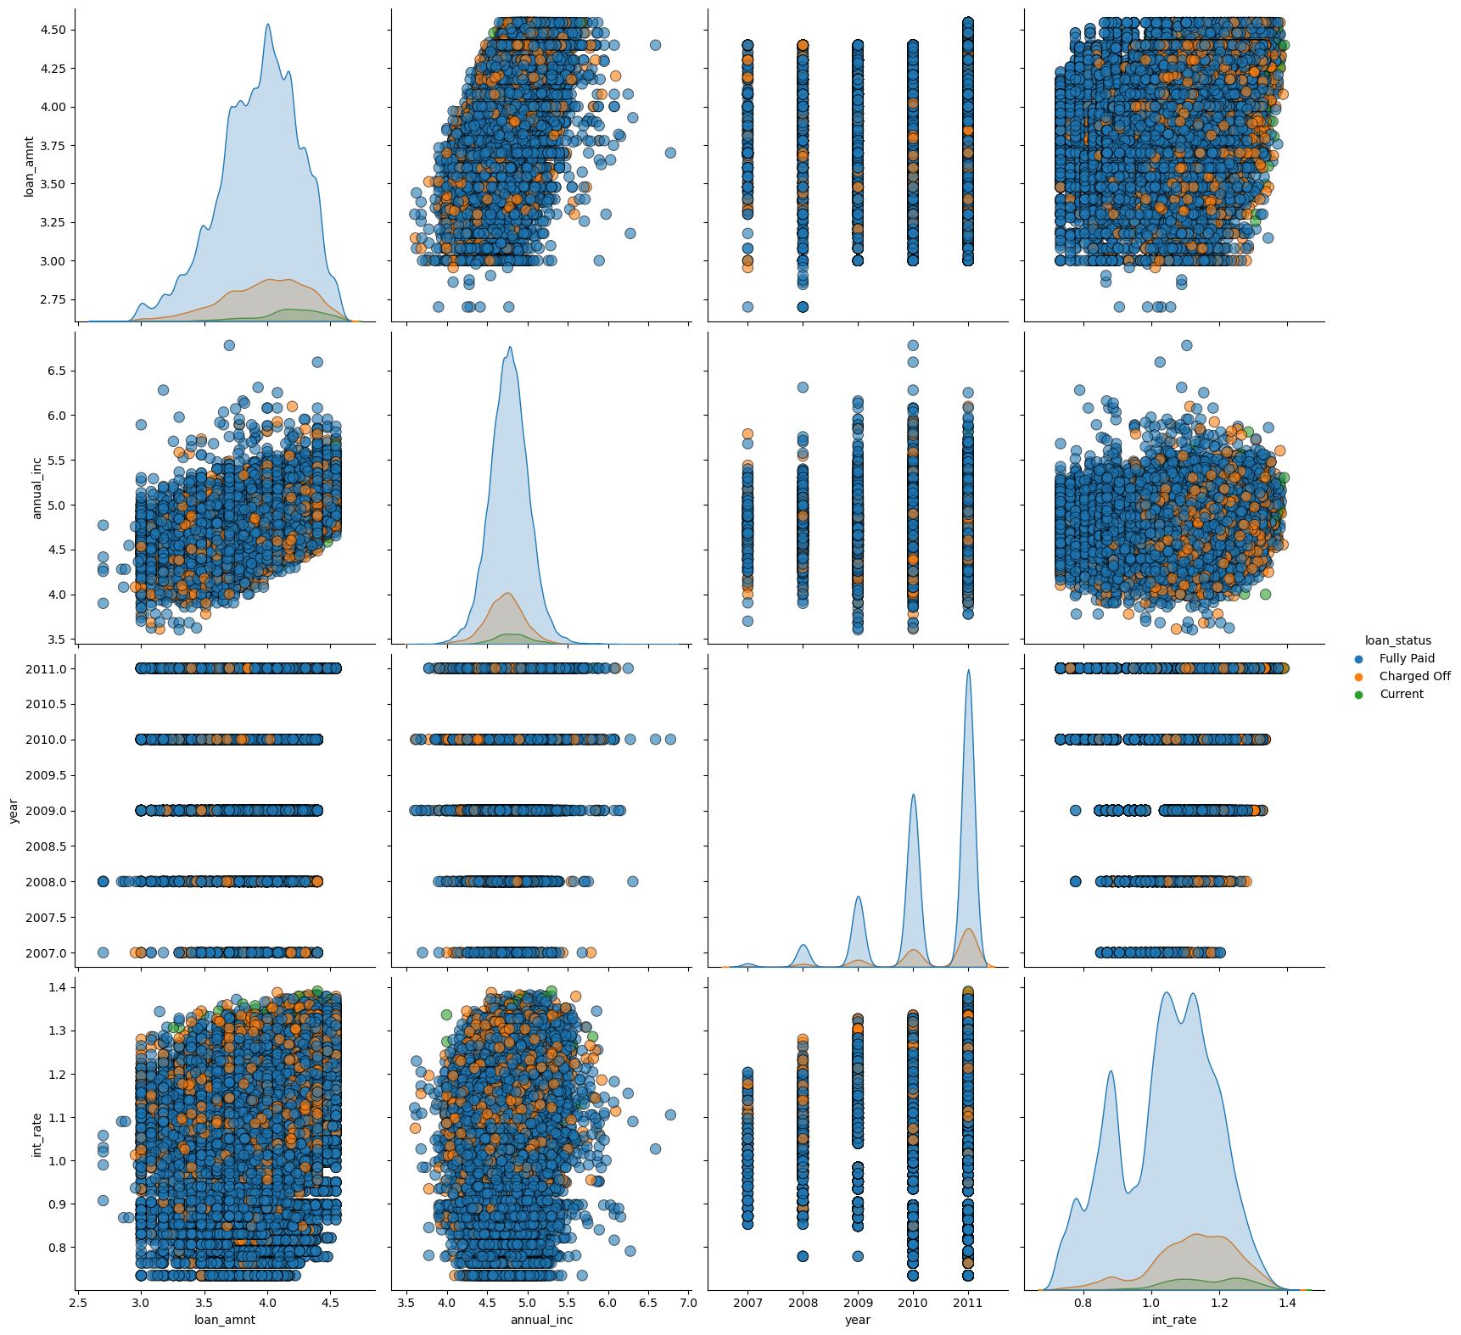
Observation:
1) Higher the interest rate higher charged off ratio
2) Higher the annual income higher the loan amount slightly.
3) increase in number of charged off with increase in year.
4) interest rate is increasing with loan amount increase

Slide 21
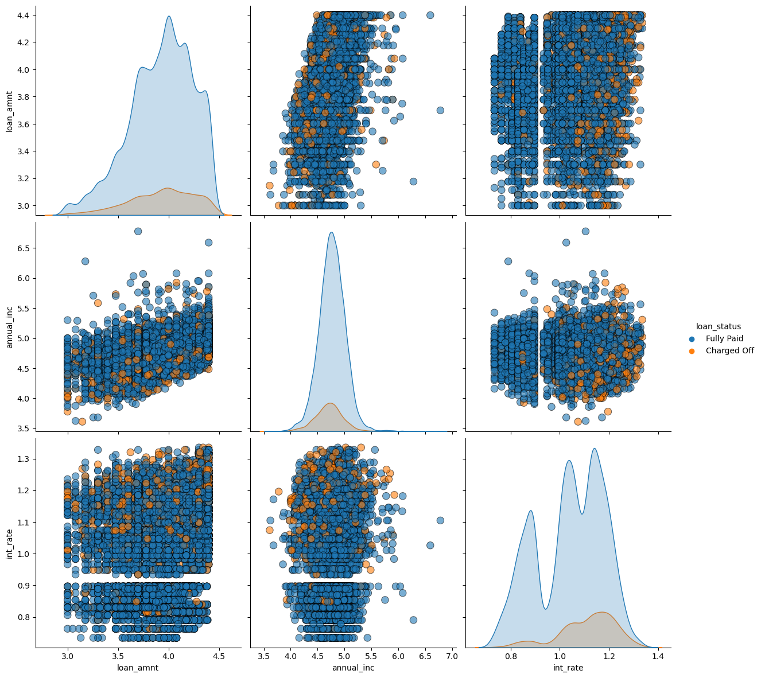
Observation: 1) Higher the intrest rate higher charged off ratio 2) Higher the annual income higher the loan amount slightly 3) Intrest rate is increasing with loan amount increase this results in high charged off.

Slide 22
Conclusion
All the below variables were established in analysis of Application data frame as leading to default.
Checked these against the Approved loans which have defaults, and it proves to be correct
Medium income
25-35 years old , followed by 35-45 years age group
Male
Unemployed
Laborer, Salesman, Drivers
Business type 3
Own House - No
Other IMPORTANT Factors to be considered
-Days last phone number changed - Lower figure points at concern
-No of Bureau Hits in last week. Month etc. – zero hits is good
-Amount income not correspondingly equivalent to Good Bought – Income low and good value high is a concern
-Previous applications with Refused, Cancelled, Unused loans also have default which is a matter of concern. This indicates that the financial company had Refused/Cancelled previous application but has approved the current and is facing default on these.

